Slide 1
Development of Therapy Efficacy Model for Autism Spectrum Disorder
Batch No: 17
Team Members:
MEGA V M (211521244032)
GURU VARSHENI A (211521244015)
DHANUSHREE S (211521244011)
Guided By:
Dr. S. Hemalatha M. E., Ph. D.
Professor and Head
Department of Computer Science and
Business Systems
Panimalar Institute of Technology

Slide 2
Abstract
Autism Spectrum Disorder (ASD) is a heterogeneous neurodevelopmental condition characterized by significant variability in therapeutic response, necessitating a paradigm shift towards data-driven, precision-based interventions.
This study proposes the development of a novel Therapy Efficacy Model (TEM) for ASD, leveraging multi-source data fusion to optimize therapy selection and efficacy prediction.
The model integrates heterogeneous multimodal datasets, including behavioural phenotyping, longitudinal therapy response trajectories, genetic predispositions, socio-environmental determinants, and neurocognitive biomarkers.
By incorporating these features, this study enables continuous monitoring of therapy progress, ensuring adaptive recommendations for personalized treatment plans.

Slide 3
Literary Survey
S. No | Year | Title | Author | Methodology | Merits | Demerits
1. | 2024 | Behavioral therapies for the treatment of autism spectrum disorder | Clara Lucato dos Santos Indyanara Inacio Barreto Ana Carolina Furian da Silva, Juliana Firmino Batista | Non-randomized clinical trials and observational studies. | Improved communication, Real time data | Limited Dataset, Lack of randomization
2. | 2024 | New advances in the diagnosis and treatment of autism spectrum disorders | Lei Qin, Haijiao Wang, Wenjing Ning, Mengmeng Cui | Reviews advancements and integrates neuroimaging, genetic screening. | Improved diagnostic accuracy, Real-time monitoring | High Cost, Standard treatment plans

Slide 4
S. No | Year | Title | Author | Methodology | Merits | Demerits
3. | 2023 | Multimodal Deep Learning in Early Autism Detection—Recent Advances and Challenges | Sheril Sophia, Jawahar Pradeepkandhasamy | Utilized deep learning techniques to analyse neuroimaging for ASD detection. | Improved early ASD detection accuracy | Computationally expensive, high hyperparameter tuning.
4. | 2021 | Developing and evaluating treatments for the challenges of autism | Leonard Abbeduto, Mustafa Sahin | explores and evaluates various treatment approaches for autism | comprehensive analysis of multiple therapeutic approaches | Dependent on observational studies so introduces bias

Slide 5
Existing System
The current landscape of therapy efficacy assessment for Autism Spectrum Disorder (ASD) predominantly relies on subjective assessment, clinical judgment, and standardized behavioral assessment tools.
These traditional approaches, while widely used, exhibit significant limitations in terms of accuracy, adaptability, and personalization.
The existing system lacks personalization, resulting in a trial-and-error approach to therapy selection. It has limited integration of advanced computational techniques, offering minimal real-time tracking and adaptation.
The absence of explainability reduces trust in predictive models and their recommendations.

Slide 6
Proposed System
The TEM combines behavioral assessments, therapy response history, cognitive function data, and socio-environmental factors for a holistic therapy evaluation.
We utilize LSTM networks, attention mechanisms, autoencoders, and ensemble learning for therapy effectiveness prediction.
Implements SHAP, Layer-wise Relevance Propagation (LRP), and feature importance analysis to enhance clinical interpretability and transparency.
The goal is to continuously monitor therapy progress over time, dynamically adjusting recommendations using reinforcement learning.
Our system integrates Bayesian optimization, to ensure unbiased and secure predictions.0

Slide 7
System Requirements
1. Hardware Requirements:
Processor: Intel i5/AMD Ryzen 5 or higher
RAM: 8 GB
Storage: 256 GB SSD
GPU : NVIDIA GPU with CUDA support
2. Software Requirements:
OS: Windows 10/11
IDE: Jupyter Notebook
ML: Random Forest, xgboost, Support Vector Machine
Visualization: matplotlib, seaborn
XAI: SHAP, LIME

Slide 8
System Architecture
Server
TEM MODEL
Doctors
Patients
Interacts with patient data
Registration
Data flow
Performs Algorithms
Explainable AI (XAI)
Therapy booking
Reviews Therapy Recommendation
ML Model Processing Layer
Patient Records
Predicts and explains therapy recommendation
Database
Notification System
Clinicial History
User Interface (UI)
Cognitive Scores

Slide 9
List of Modules
Patient Module
Server Module
Data Collection Module
Data Preprocessing Module
TEM Module
Explainable AI (XAI) Module
Doctor Module
Model Evaluation Module
Prediction Module
Notification Module

Slide 10
Algorithm
Random Forest Classifier : For ensemble learning and feature importance
XGBoost Classifier : For boosting and high prediction precision
Support Vector Machine (SVM) : For classification and decision boundaries
StandardScaler : For standardizing numerical data
LabelEncoder : For encoding categorical data into numerical labels
Recall : Measures the proportion of actual positives identified
F1-Score : Balances precision and recall
Confusion Matrix : Visualizes prediction performance
SHAP (Shapley Additive Explanations) : For feature importance and individual predictions
LIME (Local Interpretable Model-agnostic Explanations) : For local interpretability.
Bayesian optimization : To ensure unbiased and secure predictions.

Slide 11
Workflow Diagram
START
PATIENT CHECKUP
COLLECT DATA
THERAPY OPTIMIZATION
TEM SYSTEM
no
REVIEW VERIFIED
PREDICT THERAPY
yes
IMPLEMENT THERAPY
THERAPIST REVIEW
MONITOR PROGRESS
UPDATE TEM SYSTEM
STOP

Slide 12
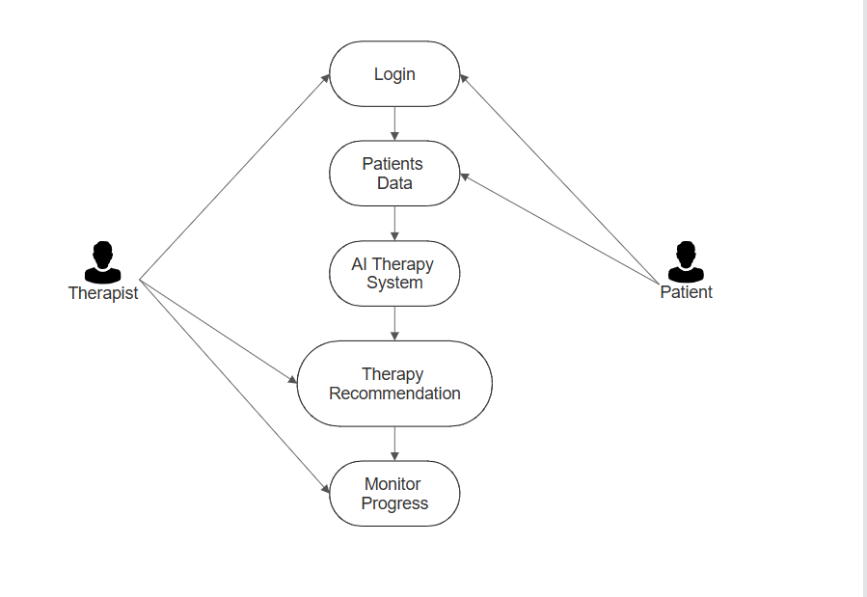
Use-case Diagram
TEM

Slide 13
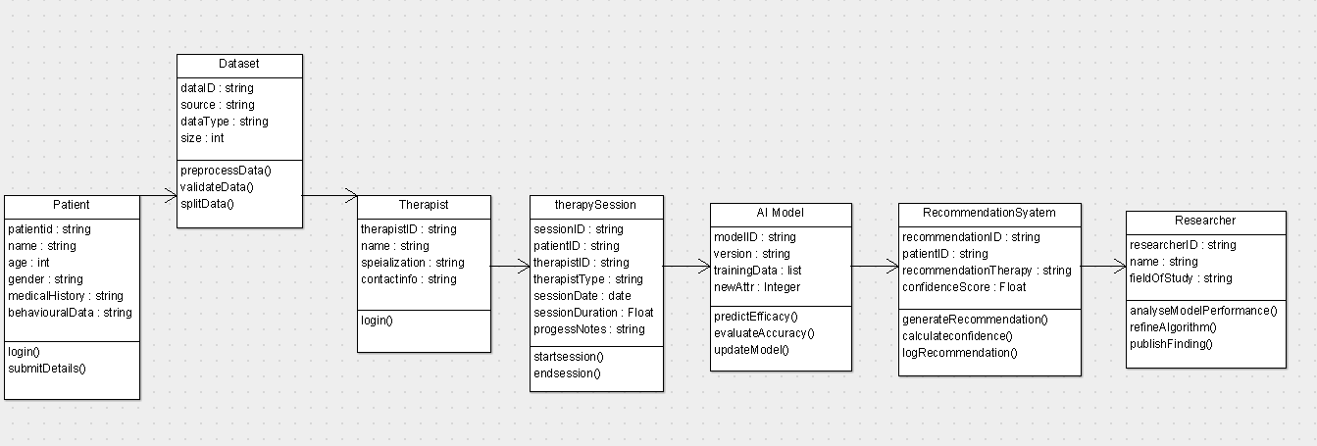
Class Diagram
TEM

Slide 14
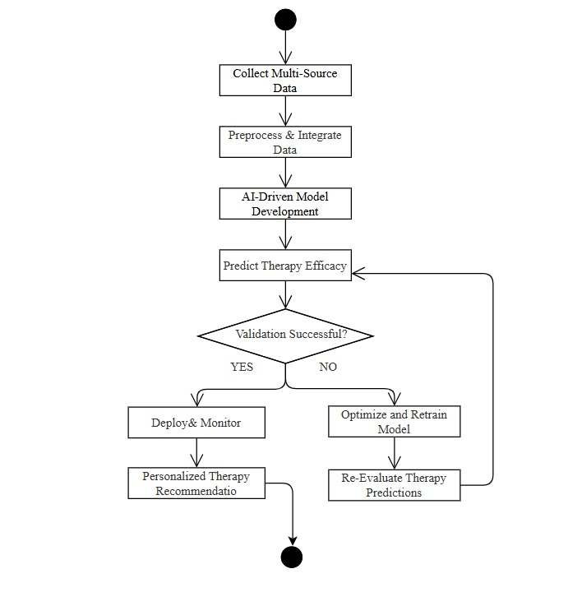
Activity Diagram
TEM

Slide 15
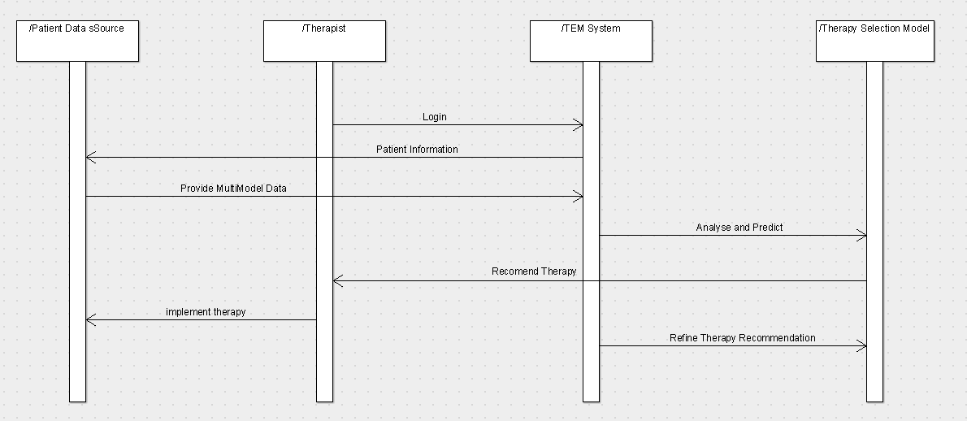
Sequence Diagram

Slide 16
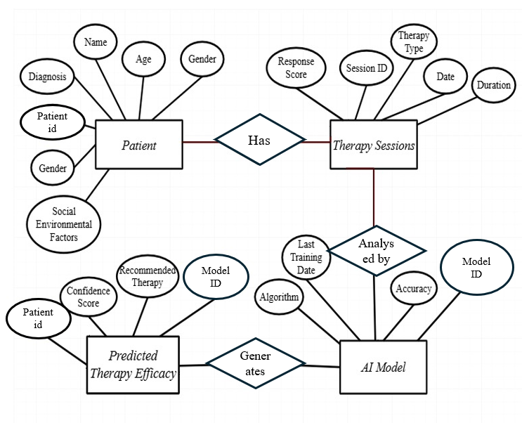
Entity Relationship Diagram
TEM

Slide 17
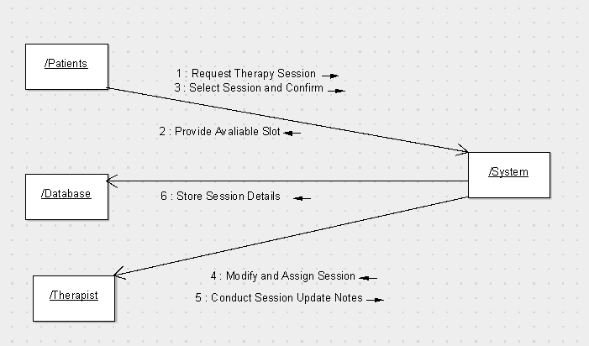
Collaboration Diagram

Slide 18
Advantages
Continuous Monitoring : Real-time tracking and assessments for therapy effectiveness.
Personalized Treatment Recommendations : Provides individualized therapy based on patient features.
Interpretability : SHAP and LIME offer clear explanations for predictions.
Longitudinal Analysis : Tracks therapy progress over time, offering insights into long-term treatment.
Adaptive Treatment Strategies : Allows dynamic modifications based on patient progress
Feature Importance Identification: Highlights critical factors like therapy intensity
Multi-Algorithm Ensemble Learning : Combines Random Forest, XGBoost, and SVM.
Efficiency : Utilizing data-driven insights and adaptive treatment strategies

Slide 19
Future Enhancements
1.Incorporation of Additional Therapies:
Extend the model to include therapies like music therapy, social skills training, and cognitive-behavioral therapy (CBT) for a broader range of treatment predictions.
2.Real-Time Data Integration:
Enable real-time data collection from wearable devices and sensors to monitor patient progress continuously. This enables timely adjustments to therapy plans, improving treatment effectiveness and personalization.
3.Adaptive Learning Mechanism:
Develop an adaptive system that updates its predictions as new patient data becomes available, ensuring dynamic and personalized recommendations.

Slide 20
Conclusion
The Therapy Efficacy Model (TEM) developed using Random Forest, XGBoost, and SVM effectively predicts the outcomes of therapies like ABA, Speech Therapy, and Occupational Therapy for individuals with Autism Spectrum Disorder (ASD). The model identifies key factors such as early intervention age, therapy intensity, and baseline severity score, aiding personalized treatment recommendations. Its use of longitudinal analysis provides insights into therapy progression over time. By incorporating demographic and socioeconomic data, the model ensures broader applicability across diverse populations.

Slide 21
References
H. Ibrahim, A. K. Al-Talabani and C. K. Loo, "Utilizing Support Vector Machine to Help with Social Robot Therapy for Autism Spectrum Disorder," 2024 21st International Multi-Conference on Systems, Signals & Devices (SSD), pp. 562-567, Apr.–June 2024.
J R. Mishra, "Towards adaptive and personalized robotic therapy for children with Autism Spectrum Disorder," 2022 10th International Conference on Affective Computing and Intelligent Interaction Workshops and Demos, Oct,2022.
A. Sandygulova, A. Amirova, Z. Telisheva, A. Zhanatkyzy and N. Rakhymbayeva, "Individual Differences of Children with Autism in Robot-assisted Autism Therapy," 2022 17th ACM/IEEE International Conference on Human-Robot Interaction (HRI), Sept.2022
S. Dobesh, J. Albert, S. Ahmed and M. Sharmin, "Moving Towards an Accessible Approach to Music Therapy for Autistic People: A Systematic Review," 2023 IEEE 47th Annual Computers, Software, and Applications Conference (COMPSAC), Torino, Italy, 2023, pp. 472-480, Jun.2023
N. A. Zakaria, N. Syazwana Tajuddin, N. F. Sufea Mohd Supian, M. Dhiya’ul Hafidh Fatah Yasin, N. Lutfiani and N. S. Ahmad, "Systematic Mapping of Telehealth Features for Autism Spectrum Disorder Children: A Preliminary Results," 2024 3rd International Conference on Creative Communication and Innovative Technology (ICCIT), Tangerang, Indonesia, 2024, pp. 1-5, Aug.2024
S. Rachel, C. Buvana and S. Srinithi, "LEARNAUT - Upgraded Learning Environment and Web Application for Autism Environment using AR-VR," 2023 7th International Conference On Computing, Communication, Control And Automation (ICCUBEA), Pune, India, 2023, pp. 1-5,Aug.2023.
A. Al-Nafjan, H. Alarifi, N. Almuways, A. Alhameed and R. A. Hussain, "Artificial Virtual Reality Simulation Design for Children on Autism Spectrum Disorder," 2023 Congress in Computer Science, Computer Engineering, & Applied Computing (CSCE), Las Vegas, NV, USA, 2023, pp. 2052-2056, July.2023
S. Yu, "Analysis of VR Technology in Treating Autism," 2021 IEEE International Conference on Computer Science, Electronic Information Engineering and Intelligent Control Technology (CEI), Fuzhou, China, 2021, pp. 72-75, Sept.2021
M. Santiputri, E. B. Sembiring, N. Z. Janah and M. K. Mufida, "Abangmanis: Speech Theraphy for Autism Monitoring Mobile Application," 2019 2nd International Conference on Applied Engineering (ICAE), Batam, Indonesia, 2019, pp. 1-6, Oct.2020
C. Z. Wu, J. Q. Zheng, Z. F. He and S. C. Wang, "Application and Prospect of VR Technology in the Treatment of Autism," 2021 3rd International Conference on Machine Learning, Big Data and Business Intelligence (MLBDBI), Taiyuan, China, 2021, pp. 704-707, Dec,2021

Slide 22
Thank you

